Slide 1
Parish Council Training
27 July 2022

Slide 2
Water Neutrality

Slide 3
The Natural England Position Statement
Received September 2021
Relates to all development within the Sussex North Water Supply Zone
Identifies that water abstraction cannot be ruled out as having an adverse effect on the integrity the Arun Valley SPA, SAC and Ramsar sites
Development must not add to this impact
One way of avoiding impact is for development to be Water Neutral
As it cannot be concluded that the existing abstraction within Sussex North Water Supply is not having an impact on the Arun Valley site, we advise that developments within this zone must not add to this impact’
Notes:
Intro – who we are, experience

Slide 4
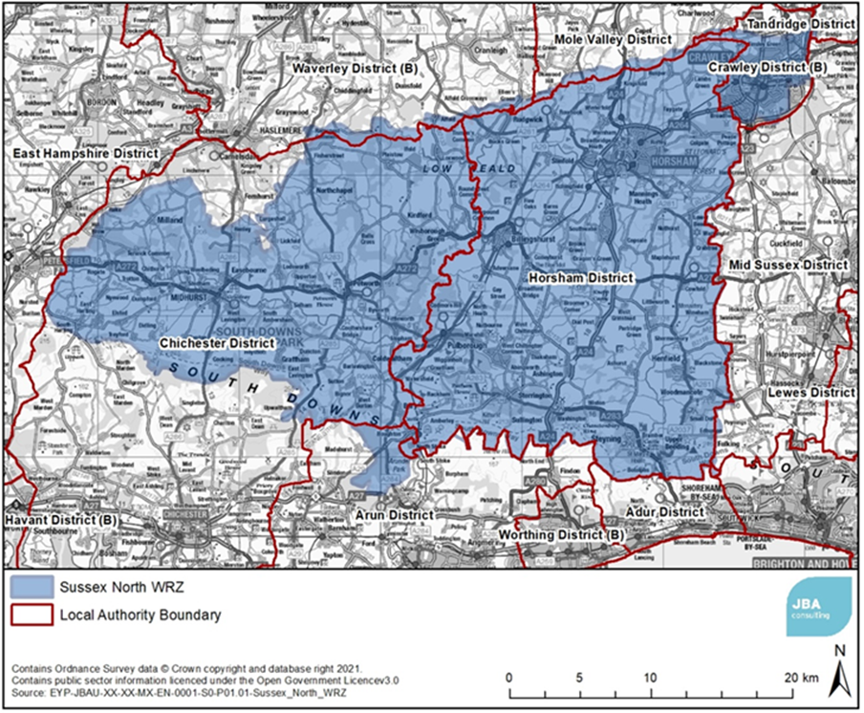
The Sussex North Water Supply Zone

Slide 5
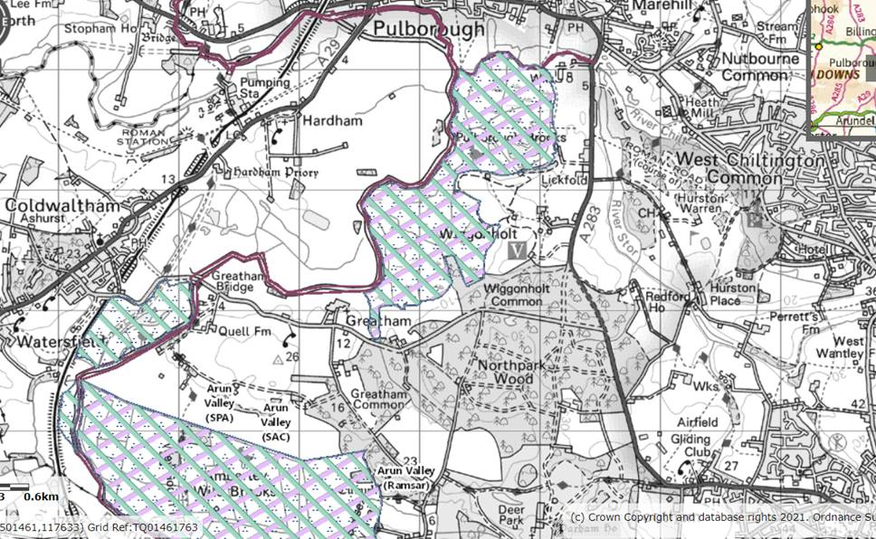
The Arun Valley SPA, SAC and Ramsar sites
All of Sussex North Water Supply comes from the abstraction point at Hardham, just south of Pulborough
Arun Valley habitat sites
Notes:
Talk through data collection & processing
Include map with sites overlay?

Slide 6
How can applicants demonstrate water neutrality?
A Water Neutrality Statement is now required for all development that consumes water
The Council has set out guidance in its FAQs document available on the water neutrality pages of the website https://www.horsham.gov.uk/planning/water-neutrality-in-horsham-district/water-neutrality-and-planning-applications
This guidance is evolving- it should be noted that we are the first authorities that have been required to ensure all development is water neutral, there are no precedents to follow.
It is important to note that the requirement for water neutrality extends to all development granted by the GPDO- ie all Permitted Development that will increase water consumption at a site
Notes:
Talk through data collection & processing
Include map with sites overlay?

Slide 7
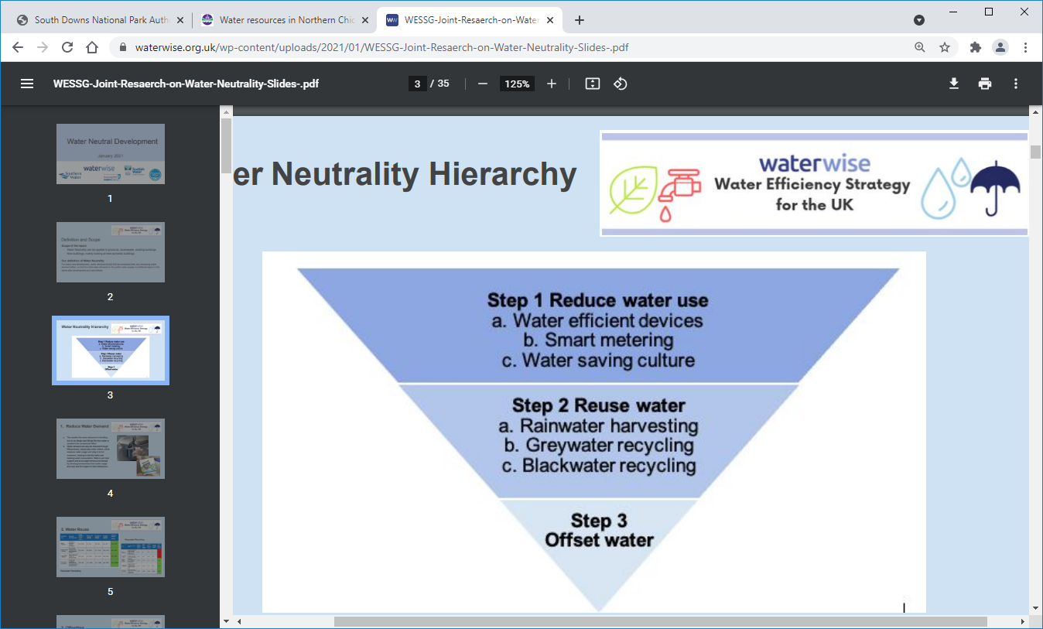
How do we secure development as water neutral?
There are three means to achieve water neutrality:
Reduce water consumption at a site using more efficient fixtures and fittings.
Include Rainwater and/or Greywater harvesting in development proposals
Offset the water consumption on another site
Notes:
Talk through data collection & processing
Include map with sites overlay?

Slide 8
What do we expect to see in a Water Neutrality Statement?
Baseline water consumption data
This must set out clearly evidence of the water consumption of the existing site in its existing or last known use from the last 3 years, eg existing water bills.
Proposed water consumption data
Should be based on an industry standard water calculator where possible- eg for residential uses, the Building Regulations Part G calculator; for commercial, the BREEAM Wat 1 calculator.
If including rainwater/greywater harvesting, yield data and detail on the drought storage and how the water is to be used must be included
Offsetting
If offsetting on third party land, full detailed evidence to support the existing water consumption and proposed offsetting must be included. The landowner will be required to enter into a s106 to secure the measures in perpetuity.
Notes:
Talk through data collection & processing
Include map with sites overlay?

Slide 9
How do we secure development as water neutral?
Reducing water consumption
For domestic consumption, the Building Regulations Part G water calculator provides a standardised means of evidencing reduced consumption. Measures include:
Installing more efficient toilets
Installing more efficient taps and shower heads
Installing smaller or shallower baths
Installing washing machines and dishwashers that consume less water
The Part G calculator returns a final per person consumption figure based on the fixtures and fittings used
Notes:
Talk through data collection & processing
Include map with sites overlay?

Slide 10
How do we secure development as water neutral?
2. Rainwater and Greywater Harvesting
Rainwater harvesting
Part G of the Building Regulations provides a calculator for the water yield of a roof
This water can be directed for use primarily for toilets, external use, and washing machines, saving around 30-40 l/p/d
It can also be used for potable water provided it is appropriately filtered (this is then monitored by the Environmental Health team as a private water source)
An important consideration is ensuring there is sufficient drought storage capacity included in the proposals
Greywater harvesting
This water is recycled from showers, washing machines etc for use in toilets, washing machines and for external use.
Drought storage is not a requirement as the water is derived from everyday use, although some storage is still required.
More costly than rainwater harvesting
Notes:
Talk through data collection & processing
Include map with sites overlay?

Slide 11
How do we secure development as water neutral?
3. Offsetting
Offsetting must take place on a site that:
  Is located within the Sussex North Supply Zone; and
  Demonstrates it takes it’s water at the required volume from the mains supplied from the Sussex North Supply Zone
  The landowner will be required to enter into a s106 to commit to retaining the water efficiencies being proposed (in most cases likely to be rainwater harvesting)
  We must be sure the offsetting site is not ‘double counted’ from another permission in the affected districts.
Notes:
Talk through data collection & processing
Include map with sites overlay?

Slide 12
The Habitat Regulations Assessment (HRA)- Appropriate Assessment
Required to be carried out by the ‘competent authority’ before deciding to grant a plan or project (s.63 Conservation of Habitats and Species Regulations 2017)
A precautionary approach must be taken at each stage of the HRA process.
Any mitigation measures must:
  be ‘sufficiently robust and achieve the required certainty’ so as to not give rise to an adverse effect on integrity of the Arun Valley sites (PPG: Paragraph: 006 Reference ID: 65-006-20190722);
  leave the decision maker in ‘no reasonable scientific doubt as to the effects of the proposed plan or project.’ (Paragraph: 003 Reference ID: 65-003-20190722); and
  be ‘sufficiently secured and likely to work in practice’ (Paragraph: 004 Reference ID: 65-004-20190722).
Notes:
Talk through data collection & processing
Include map with sites overlay?

Slide 13
The Habitat Regulations Assessment (HRA)- Appropriate Assessment
  Decision makers must have an understanding of how the measures would be implemented and monitored, and how they would be enforced.
  Further, there must be certainty that the measures would work to avoid or reduce effects on the site.
In short, the Habitat Regulations set a very high bar for the level of information and evidence required to pass Appropriate Assessment.
Planning Inspectors follow this guidance and apply the same high bar of certainty.
Notes:
Talk through data collection & processing
Include map with sites overlay?

Slide 14
What is happening in practice
NPPF is clear that planning permission should be refused for development that would result in significant harm to biodiversity and/or result in the loss or deterioration of irreplaceable habitats.
Furthermore, where an adverse impact on a habitats site is identified and constitutes a clear reason to refuse permission, the ‘tilted’ balance of NPPF is not applied. Therefore water neutrality trumps the Council’s lack of a 5YHLS.
The Planning Inspector is supporting this position. 18 March decision for 4 dwellings in Pulborough:
‘The proposal would adversely affect the integrity of the SPA/SAC. There are no imperative reasons of overriding public interest and in these circumstances Regulation 63(5) of the Conservation of Habitats and Species Regulations precludes the proposal from proceeding….There is insufficient certainty as to how water neutrality can be achieved and so it would not be reasonable to impose a condition…’
Notes:
Talk through data collection & processing
Include map with sites overlay?

Slide 15
Reasons for Refusal
Each refusal reason must be:
  Defensible in its own right
  Clearly worded to explain the harm
  Reference the policies conflicted
  Be evidential, and reasonable
  Failure to properly justify reasons for refusal may lead to an award of (potentially significant) costs against the Council.
  Risk of special measures (ie loss of right to determine major applications)
  An award can be against one bad refusal reason, even if an appeal is dismissed for other refusal reasons
  It is not acceptable to refuse an application on multiple grounds simply to emphasis dislike for a proposal, or in hope that at least one reason sticks.
Notes:
Talk through data collection & processing
Include map with sites overlay?

Slide 16
Questions to ask before refusing an application:
Are you able to describe the harm that would result if the development went ahead? And why conditions would not be sufficient to mitigate that harm?
Is it clear what the policy support is for the decision?
Have all the other material considerations been given the appropriate weight?
Are the reasons lawful (which includes being generally “reasonable”)?
Are they based on planning grounds?
Could you mount a credible case on appeal?
Is there a sufficient “evidential basis” for the decision?
Would anyone reading the decision – especially the applicant – understand why permission was refused?
If it was the only reason to refuse permission, would it stand up in its own right as reasonable, resulting in identifiable, evidential harm based on policy conflict that is not outweighed by the benefits of the proposal?
Notes:
Talk through data collection & processing
Include map with sites overlay?

Slide 17
Local Plan – Implications
Work ongoing on a Strategic Mitigation Strategy
‘Part A’, ‘Part B’ ‘Part C’ – together these outline the demand for water and the ways this can be met. Eg, building design, rainwater harvesting, leakage reduction, alternative water sources.
Timescale highly dependent on third parties, but aiming for the autumn
If agreed, this will unlock plan preparation
Notes:
CH to refer to Jonathan to cover off Cabinet Member Meetings

Slide 18
Local Plan – Implications
Water Neutrality – likely to impact the amount of development we can bring forward and when (lower in the short term in particular). This will impact on how much housing we can bring forward over the plan period.
Government changes to planning system – a new local plan system set out in Levelling Up bill, but shorter term updates on NPPF / housing targets delayed.
Seek to progress under current system – greater local control over policies.
Notes:
CH to refer to Jonathan to cover off Cabinet Member Meetings

Slide 19
Neighbourhood Plan – Implications
Plans which are not yet ‘Made’ must also demonstrate Water Neutrality – a legal requirement
The wider strategic solution will also unlock NP preparation for those currently awaiting referendum / otherwise on hold.
Speculative development – ‘premature’ as it will use up our water balance. (But may be tested at Appeal)
Reviews of existing plans – likely impacted by quantum of development that can come forward in the plan period. In the shorter term – would also need to demonstrate water neutrality.

Slide 20
Q&A

