Slide 2
Introduction to RWE Rampion 2 Proposal
Ashurst Parish Council Briefing
10th February 2021

Slide 3
Outline
1 | Introduction to RWE
2 | Why are we considering expansion at Rampion?
3 | Offshore project ‘Area of Search’
4 | Grid connection and onshore options
5 | Community engagement & consultation
6 | Indicative timeline
7 | Q&A

Slide 4

1. Introduction to RWE
International energy company with power generation, trading and supply divisions
The original Rampion project developer (E.ON Climate& Renewables) is now part of RWE
Commitment to become Carbon Neutral by 2040: renewable energy key to this
Developing Rampion 2 as a Joint Venture with same partners as original project
RWE is managing the development on behalf of the JV with a team comprised of many of the original project team.
Corporate website for more info: www.rwe.com

Slide 5
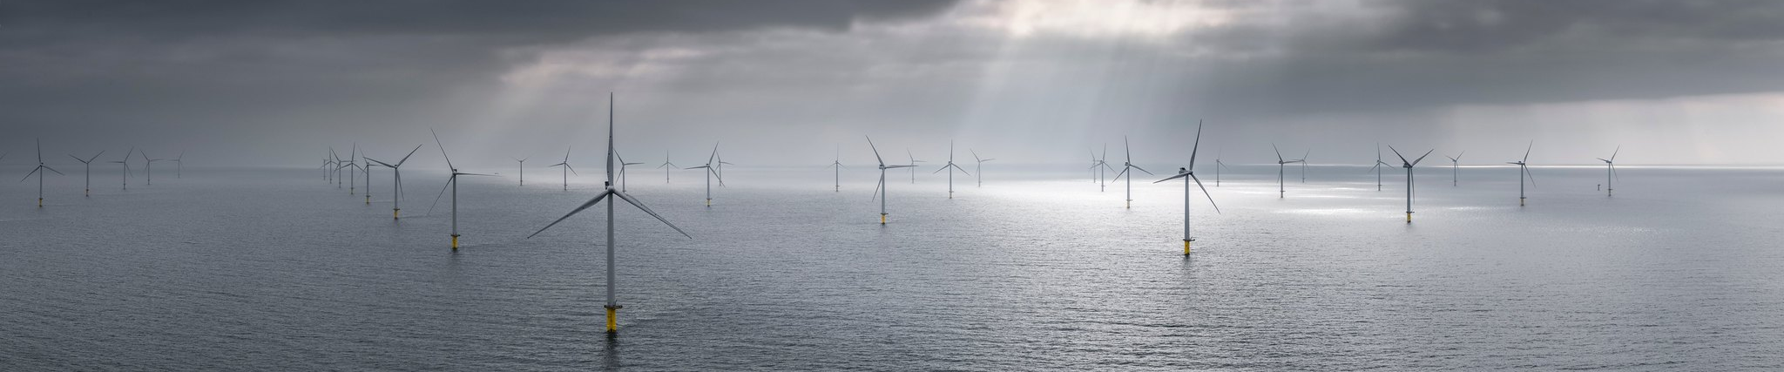

2. Why are we considering expansion at Rampion?
UK Govt has formally declared a Climate Emergency, set a National Determined Contribution under the Paris Climate Agreement of a 68% reduction in GHG emissions by 2030, compared to 1990 levels, and set a target to quadruple offshore wind capacity to 40 Gigawatts (GW) by 2030.
Last 5% coal plant being phased out, while hydrogen, heat pumps and EVs all coming in, leading to an increased need for electricity generation from renewable energy sources
Wind energy currently supplies 20% of electricity in the UK (onshore 10%, offshore 10%) and up to half of our electricity on a good day. 2050 target to make the UK ‘Net Zero’ carbon emitter.
Offshore wind is a proven technology, is leading the way for renewables and can be built at scale. Costs halved in 2 - 3 years as the industry has scaled up. Modern turbine 3 x power of Rampion.
Currently 40+ offshore wind farms around UK waters – Rampion the only project off the south coast of England where much of the electricity demand is. There is scope for the area to make further important contribution to clean sustainable energy supplies
Public Opinion Survey conducted by polling organisation Populus post-construction showed 85% support for Rampion compared to 80% during early development. Just 4% negative respondents

Slide 6
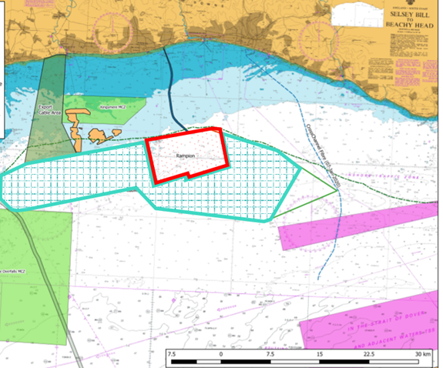
3. Offshore ‘Area of Search’
In 2018 The Crown Estate (TCE) which owns seabed in the UK invited developers to indicate their interest in future extension of existing wind farms
A sizeable area to west of the existing windfarm (previously off limits due to aggregates extraction licenses) had become available
RWE were awarded rights to this area and also proposed that any further development should also reconsider the unused area of the original Rampion Zone (‘Zone 6’)
Hatched area shows this ‘Area of Search’ has been defined including both of these areas, on which to conduct environmental and technical surveys, engage and consult with authorities, stakeholders and communities
Gives flexibility to respond to consultation feedback, constraints, objections and to shape a prospective future extension to Rampion

Slide 7
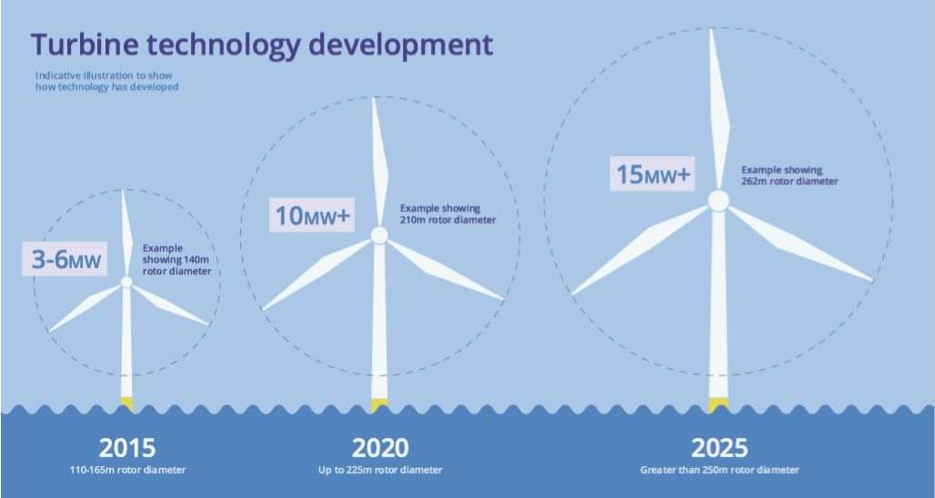
Offshore Project - Max Scope & Potential Benefits
Maximum Scope
Same minimum distance from shore as Rampion
Can’t go further offshore due to shipping lane & TSS
Maximum 116 turbines e.g. no more than Rampion
Larger turbines but increase in height does not multiply with increase in power
A 50% increase in height of a wind turbine more than doubles the power output
Potential benefits
Rampion produces clean, green electricity for the equivalent of 350,000 homes = half the homes in Sussex
Rampion 2 could could produce clean, green electricity for the equivalent of over 1 million homes!
Rampion offsets 600,000 tonnes CO₂ each year
Rampion 2 could offset 1.8million tonnes Co₂ each year

Slide 8
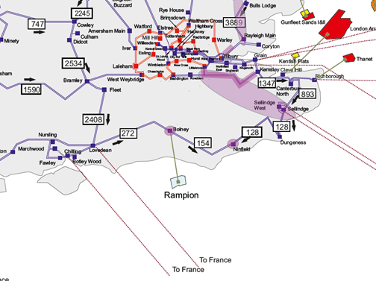
4. Onshore – Connecting to the Electricity Grid
Electricity from large generators need to connect into the 400kV National Grid transmission system
This was the case for original Rampion which connects at Bolney
The transmission system runs West-East inland between Hampshire, through Sussex to Kent
Grid Feasibility Studies carried out to look at a range of possible connection ‘nodes’ on the transmission system:-
(W to E) Fawley, Chilling, Lovedean, Bolney, Little Horsted, Ninfield
In parallel we carried out a constraints mapping study to assess various combinations of landfall, cable route and substations
National Grid have confirmed a connection agreement at Bolney for a project in 2028/2029
We appreciate that any development within or affecting the National Park will need to meet the Major Development Test and demonstrate why this is necessary and what alternatives were considered and discounted

Slide 9
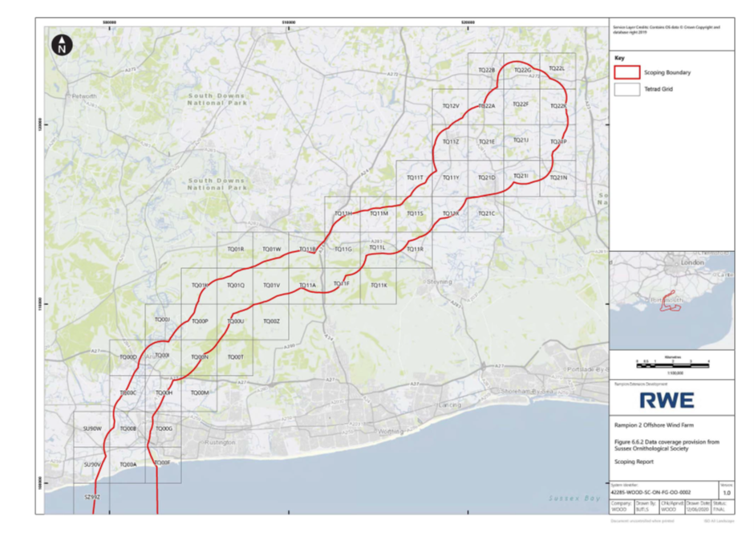
The first gap in the urban coastal strip available for landfall is Climping Beach.
We have been evaluating an area of search for the onshore cable route, between Climping & Bolney
The circuits will be undergrounded for the entire cable route from the coast to the substation
We are taking into account environmental designations & sensitivities, and technical constraints, to identify least-impact feasible route
We will take into account community feedback from our consultations
Current evaluation of 3 substation search areas being looked at, hence ‘expanded’ corridor at the northern end of corridor

Slide 10
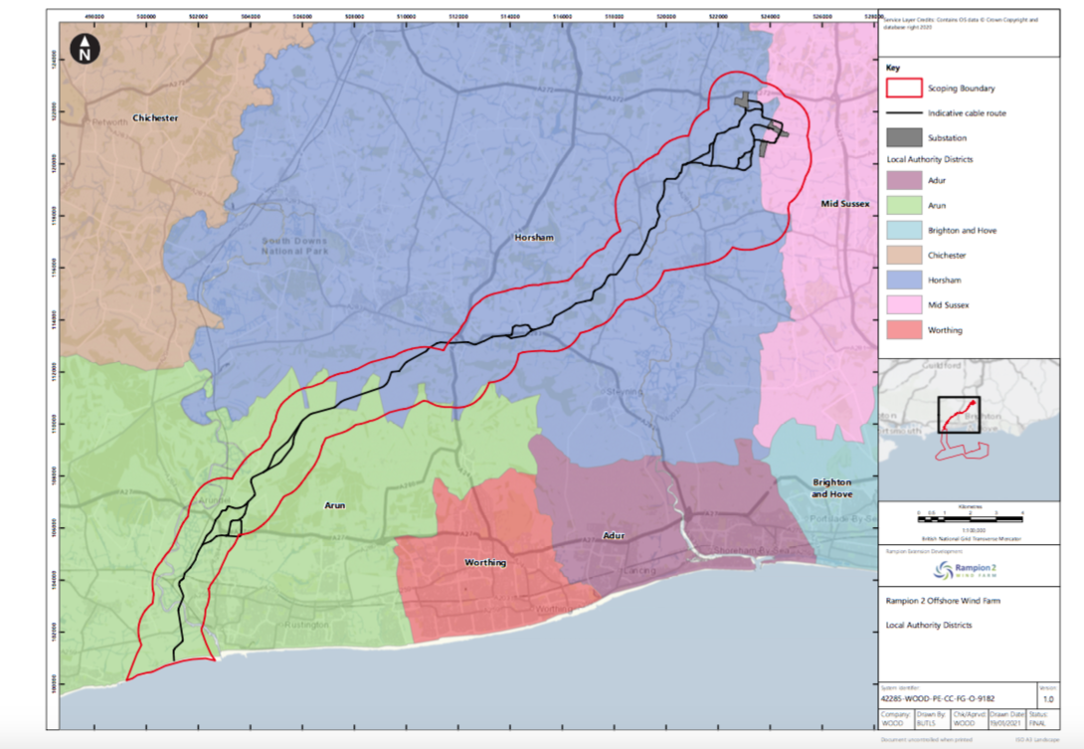

Slide 12
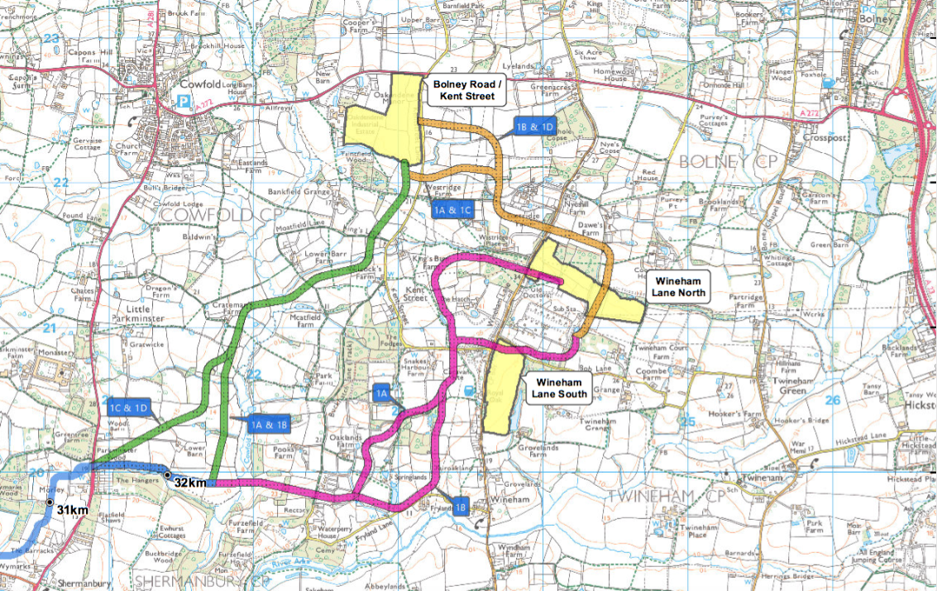
Onshore substation sites and cable route options
Shortlist of 3 site substation options we are currently considering, two in the vicinity of existing Bolney Substation, with a third option adjacent to Oakendene industrial estate
Final decision will need to take into account community feedback, environmental, technical and economic considerations
Currently engaging with Parish Councils and holding virtual informal consultation Jan/Feb 2021 to help identify issues and constraints to help refine proposals
Communities will be involved in the final decision on where substation would be sited
No final decision will be made until after Formal Consultation April/May 2021

Slide 13
5. Community engagement & consultation
Series of Expert Technical Groups & Project Liaison Groups offering two-way information dissemination and to reach a wide audience - worked well with Rampion
Early discussions held with Local Planning Authorities, South Downs National Park Authority, Parish Councils, MPs, Marine Management Organisation, Natural England, Historic England and other national bodies
Informal consultation with stakeholders and local community 14th Jan - 11th Feb 2021
We’re seeking feedback on local issues and constraints within the onshore and offshore areas of search
We’ve launched a Virtual Village Hall while offering face to face meetings via an online booking system, so that all stakeholders and communities can have their say during the ongoing COVID-19 pandemic.
The next stage of engagement would then be Formal Consultation – likely in May - July 2021
Will involve more specific information about the offshore scope, a refined onshore cable route and substation site options under consideration and we will be inviting feedback (in this case on the merits / relative merits of options) to help refine our proposals
We’ll be required to produce a Statement of Community Consultation (‘SoCC’) which we need all of the local planning authorities to sign off, to set out exactly how we will formally consult with communities
We have to carry out the consultation in accordance with the approved SoCC, which ensures a thorough and meaningful consultation process is carried out
A Consultation Report is then produced detailing all of the consultation feedback, analysis and how this has been addressed, which forms an integral component of the consent application

Slide 14
6. Indicative timeline*
*Subject to COVID-19 restrictions and other factors
Milestone | Date
Formal EIA Scoping Opinion | Q2 2020
Stakeholder engagement to help shape proposals | Q3 2020 - Q1 2021
Statement of Community Consultation (SoCC) | Q1 2021
Refined proposals, Draft EIA and Formal Consultation | Q2 - Q3 2021
Onshore substation site selection decision | Q3 2021
Indicative timing for formal consent application | Late 2021
Consent Examination Process | 2022 - early 2023
Earliest possible investment approval | End 2024
Earliest possible construction work | 2025/26

Slide 15
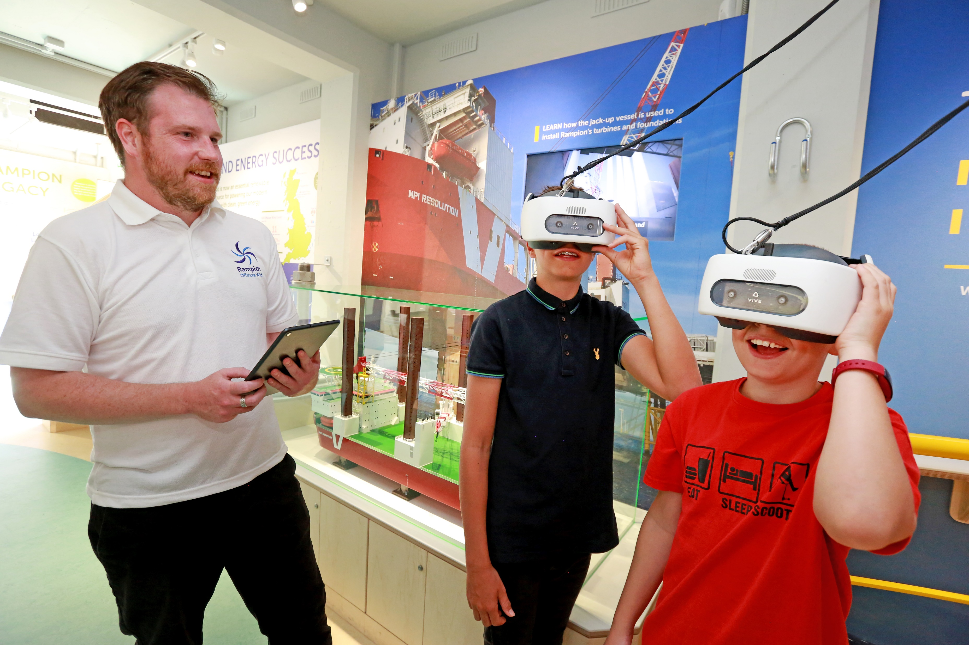
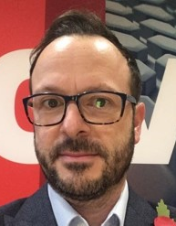
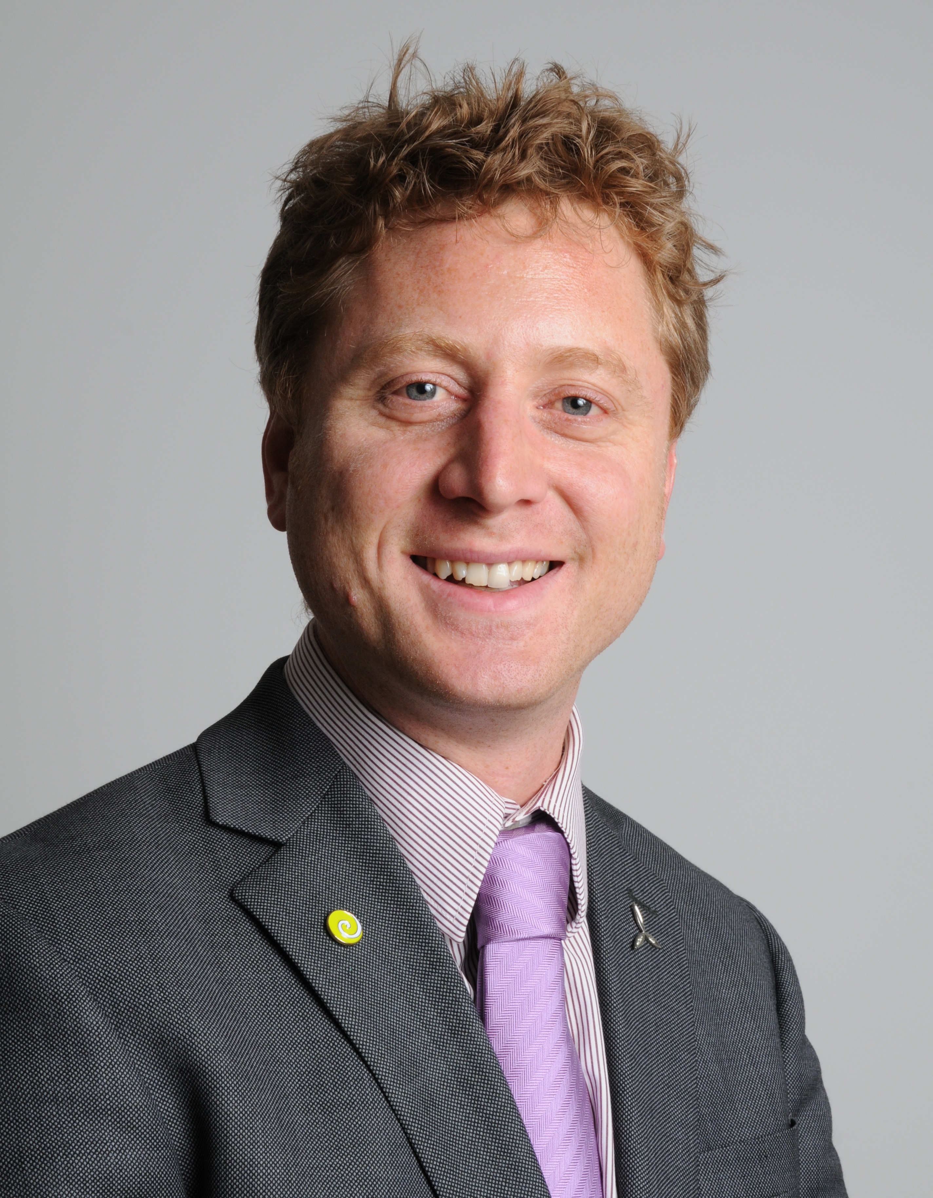
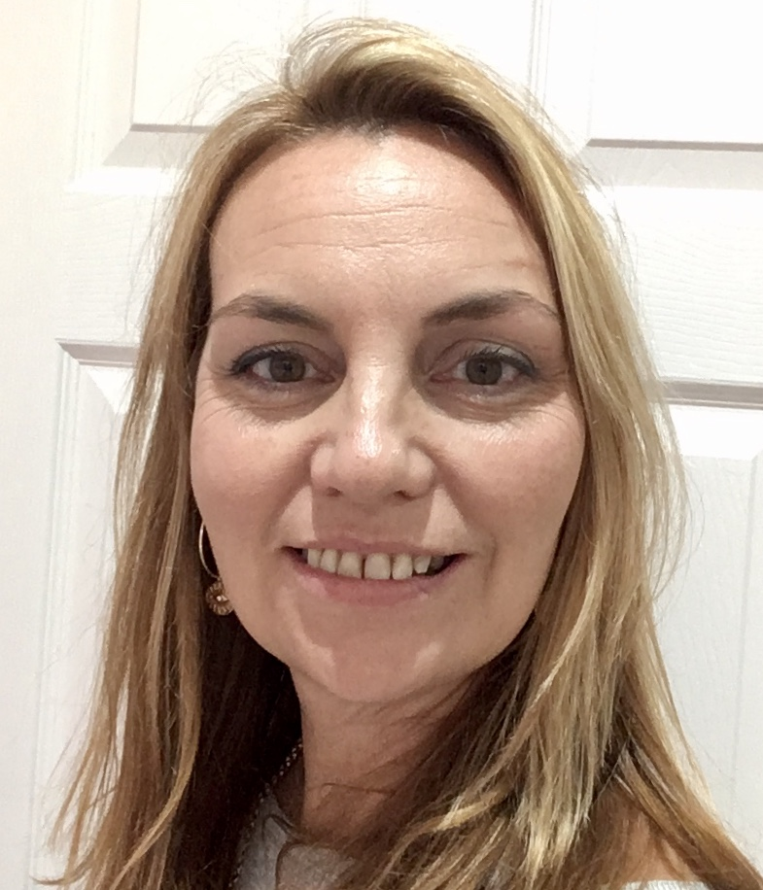
7. Q & A
Vaughan Weighill
Project Manager
vaughan.weighill@rwe.com
Chris Tomlinson
Stakeholder Manager
chris.tomlinson@rampionoffshore.com
Eleri Wilce
Consents & Permitting Manager
eleri.wilce@rwe.com
Have you visited our Rampion Visitor Centre on Brighton seafront?

Slide 16
www.rampion2.com

